Slide 1

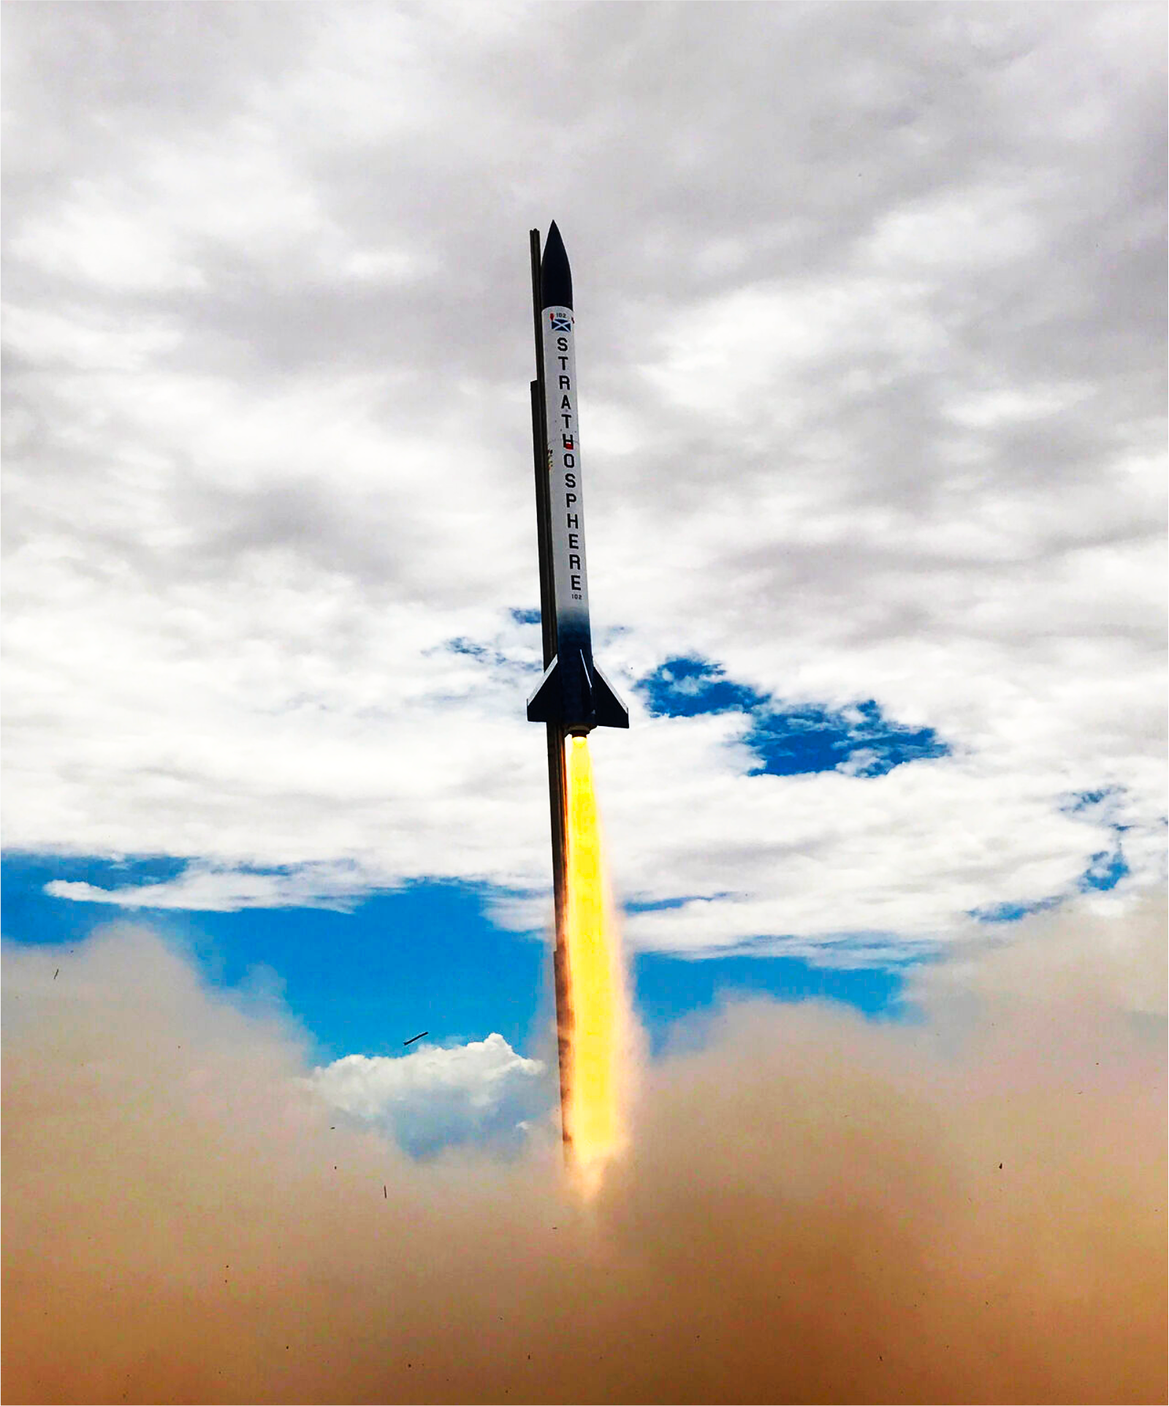
Avionics

Slide 2
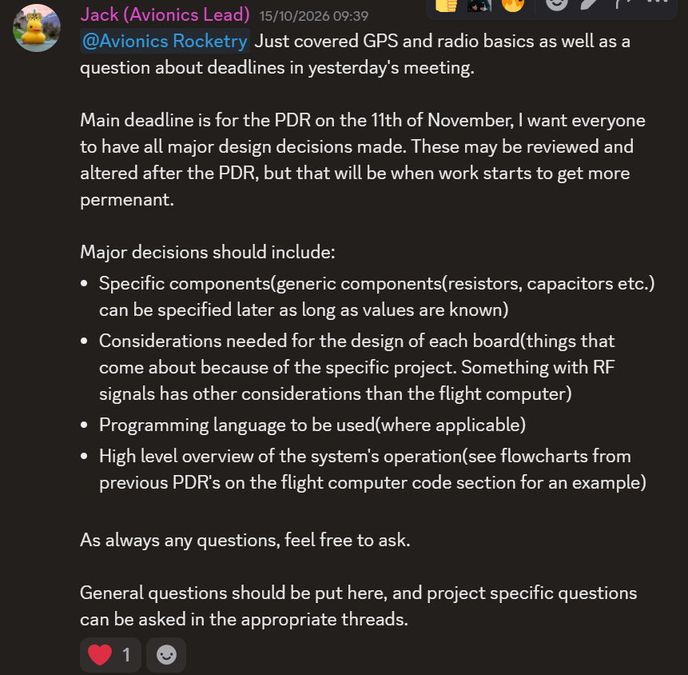
PDR Reminder
Wednesday 11th November
After classes
It’s one of the structures lead’s birthdays so we will be singing
Maybe cake
I recommend going
Start thinking about your slides
Those who are ready should start making them
Want a template?

Slide 3
GitHub
Aurelija, Nicholas and Zach are good
I still need to add everyone else

Slide 4
On to what all of you have done
Power management
Telemetry visualization
SRAD flight computer
SRAD radio
SRAD GPS

Slide 5
Right, you’re all bored as hell now
What’ve you lot got to say to me?
I’m sure you have notes

Slide 6
Subcrawl
On Friday
Would recommend
Make friends so you can get them to make things for you

